Slide 1

Software requirements (swr302)
Playing By the Rules (chapter 09)

Slide 2
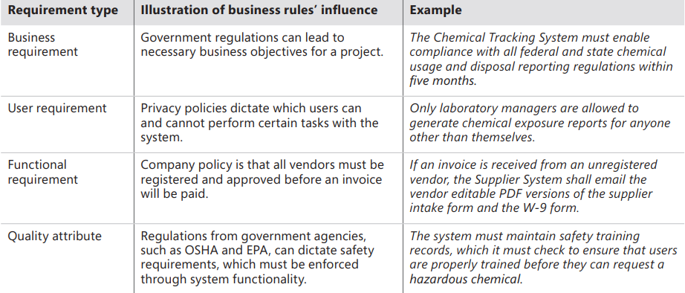
Business rules overview
Business rules include policies, laws, and industry standards that an organization’s operation must comply.
How business rules can influence various types of software requirements

Slide 3
Business rules overview
A business requirement states a desirable outcome or a high-level objective of the organization that builds or procures a software solution
A business process describes a series of activities that transform inputs into outputs to achieve a specific result
Business rules influence business processes by establishing vocabulary, imposing restrictions, triggering actions, and governing how computations are carried out

Slide 4
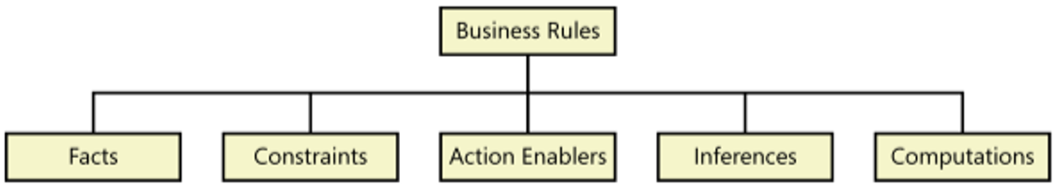
A business rules taxonomy
Definition:
From the business perspective: “A business rule is guidance that there is an obligation concerning conduct, action, practice, or procedure within a particular activity or sphere”
From the information system perspective: “A business rule is a statement that defines or constrains some aspect of the business. It is intended to assert business structure or to control or influence the behavior of the business“
A simple business rule taxonomy
Notes:
Taxanomy: phân loại
0/ Facts are simply statements that are true about the business at a specified point in time.
1/ A constraint is a statement that restricts the actions that the system or its users are allowed to perform. Someone describing a constraining business rule might say that certain actions must or must not or may not be performed, or that only certain people or roles can perform particular actions.
2/ A rule that triggers some activity if specific conditions are true is an action enabler. A person could perform the activity in a manual process. Alternatively, the rule might lead to specifying software functionality that makes an application exhibit the correct behavior when the system detects the triggering event
3/ Sometimes called inferred knowledge or a derived fact, an inference creates a new fact from other facts. Inferences are often written in the “if/then” pattern also found in action-enabling business rules, but the “then” clause of an inference simply provides a piece of knowledge, not an action to be taken.
4/ Computations that transform existing data into new data by using specific mathematical formulas or algorithms. Many computations follow rules that are external to the enterprise, such as income tax withholding formulas.

Slide 5
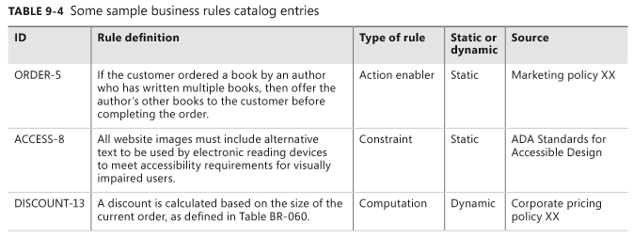
Documenting business rules
The “Static or dynamic” column indicates how likely the rule is to change over time. This information is helpful to developers. If they know that certain rules are subject to periodic change, they can structure the software to make the affected functionality or data easy to update.

Slide 6
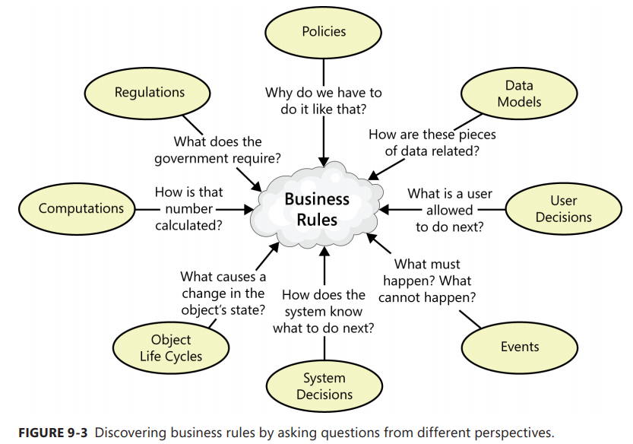
Discovering business rules

Slide 7
Business rules and requirements
After identifying and documenting business rules, determine which ones must be implemented in the software.
Business rules and their corresponding functional requirements sometimes look a lot alike. However, the rules are external statements of policy that must be enforced in software, thereby driving system functionality.
Every BA must decide which rules pertain to his application, which ones must be enforced in the software, and how to enforce them.

Slide 8
Tying everything together
To prevent redundancy, don’t duplicate rules from your business rules catalog in the requirements documentation.
Instead, refer back to specific rules as being the source of certain functionality or algorithms.
You can define the links between a functional requirement and its parent business rules in several ways-
If you are using a requirements management tool, create a requirement attribute called “Origin” and indicate the rules as being the origin of derived functional requirements.
Define traceability links between functional requirements and the connected business rules in a requirements traceability matrix or a requirements mapping matrix
If the business rules and requirements are stored in word processing or spreadsheet files, define hyperlinks from business rule ID references in the requirements back to the descriptions of the business rules stored elsewhere. Be aware that hyperlinks are prone to breaking if the location of the rules collection changes.

Slide 9


